Slide 1
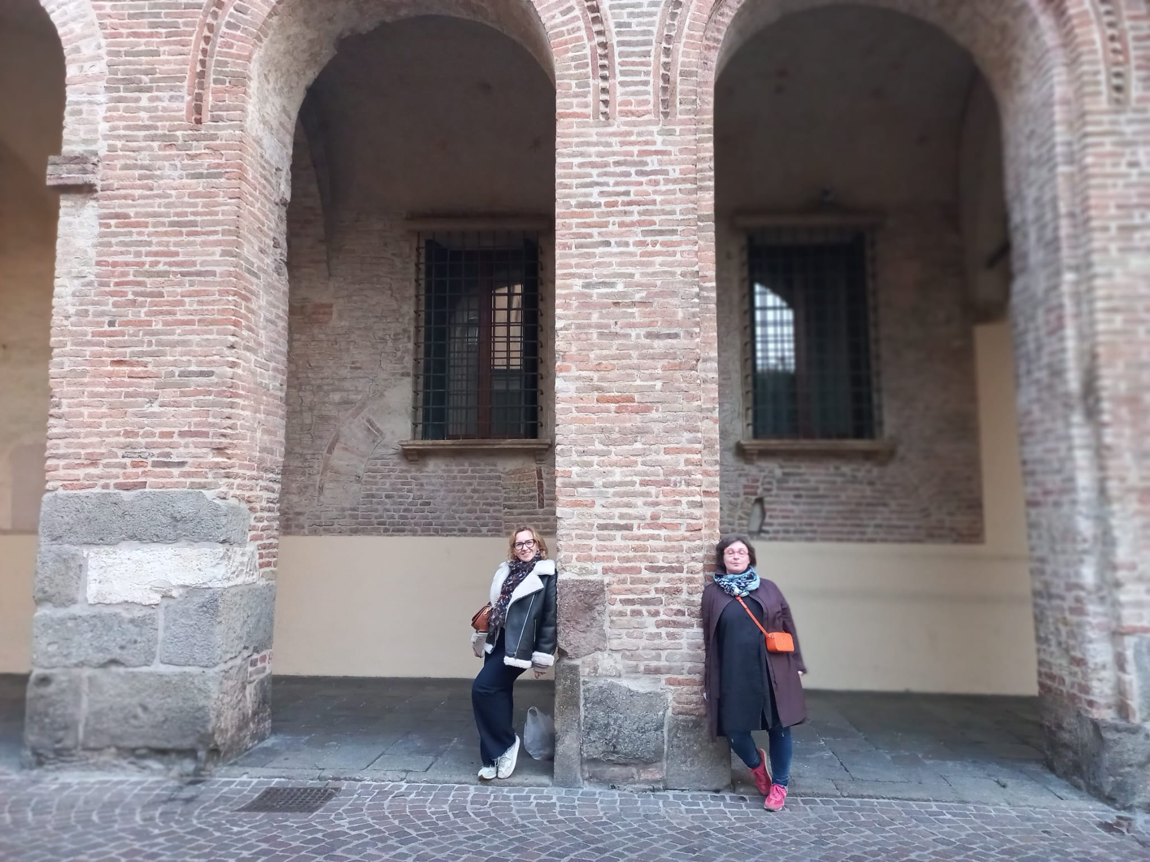
Erasmum+Padova+Izolda+Beata

Slide 2
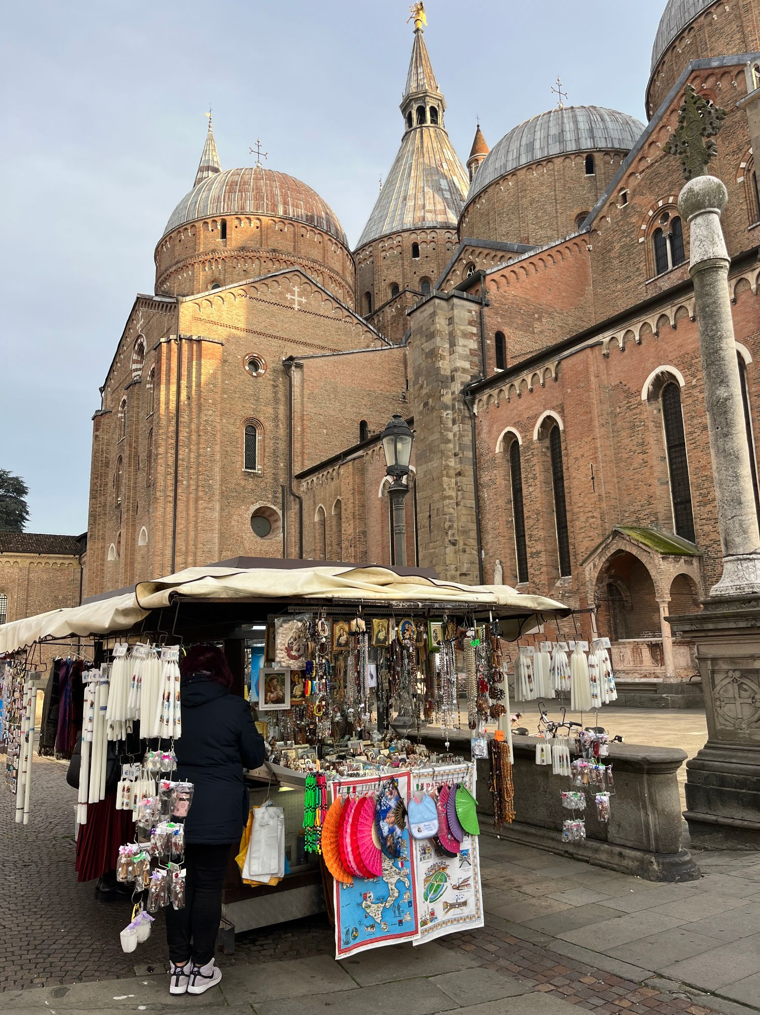
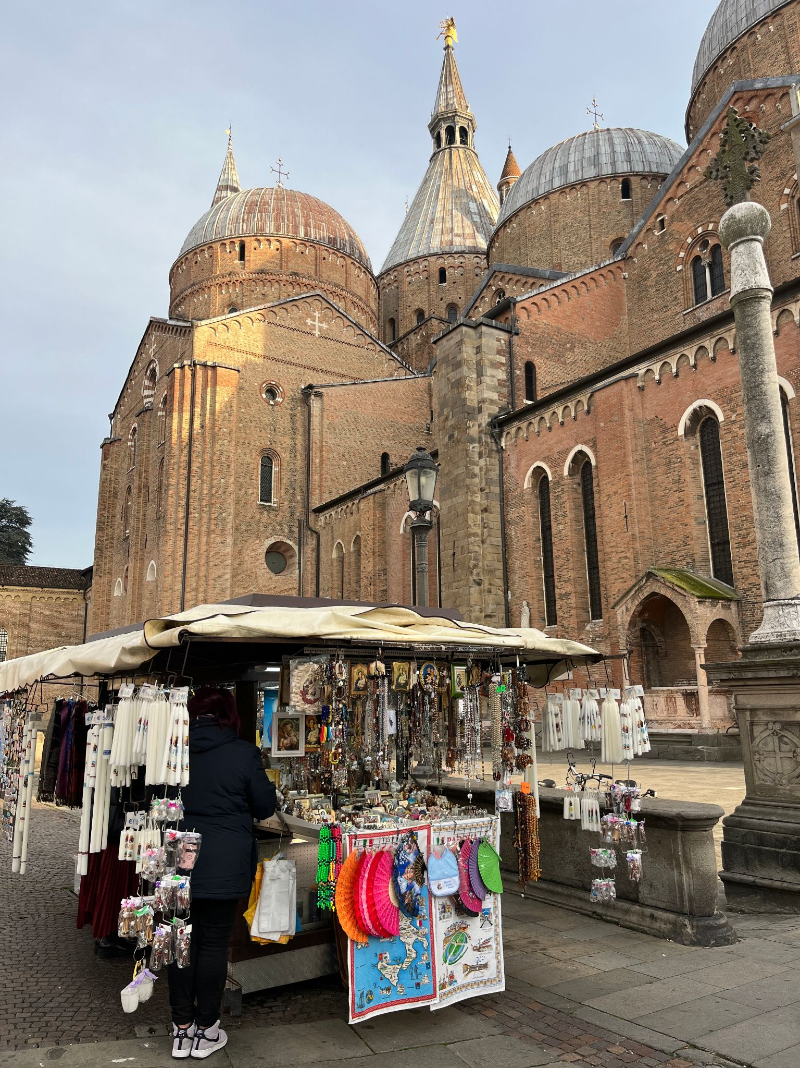
STEAM.4 ﻿﻿ The architecual styles to be found in Padua.
Romanesque,
Saint Anthony Basiclica

Slide 3
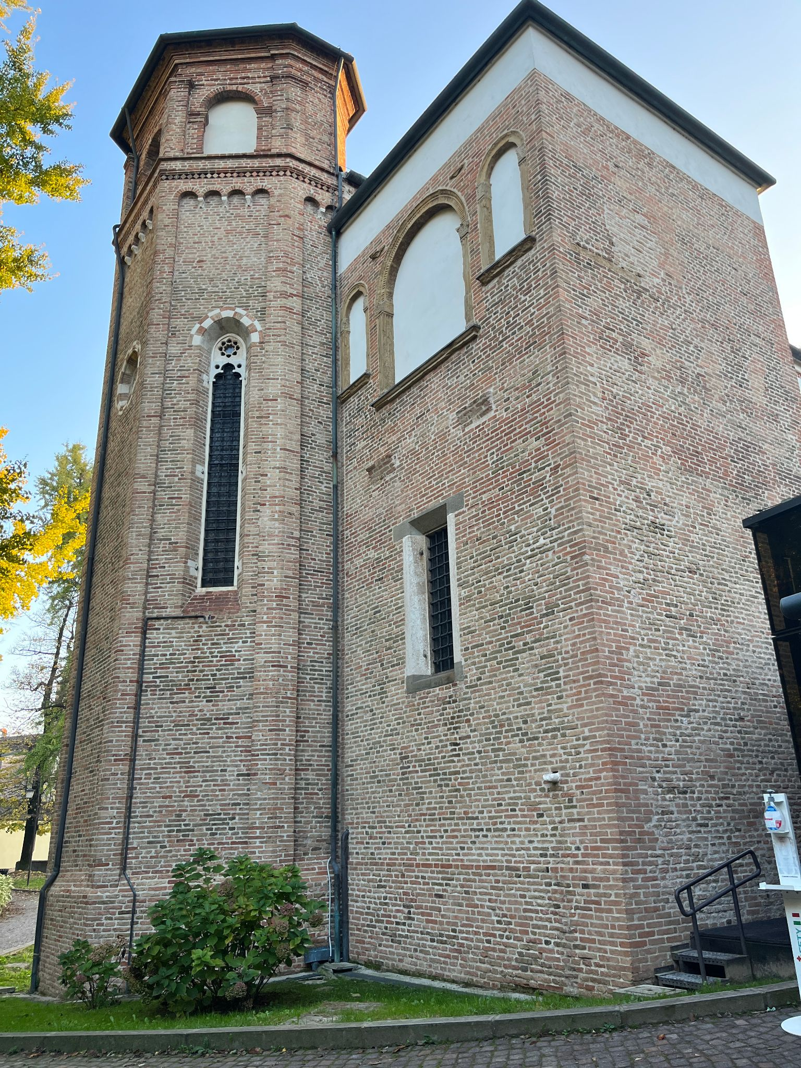
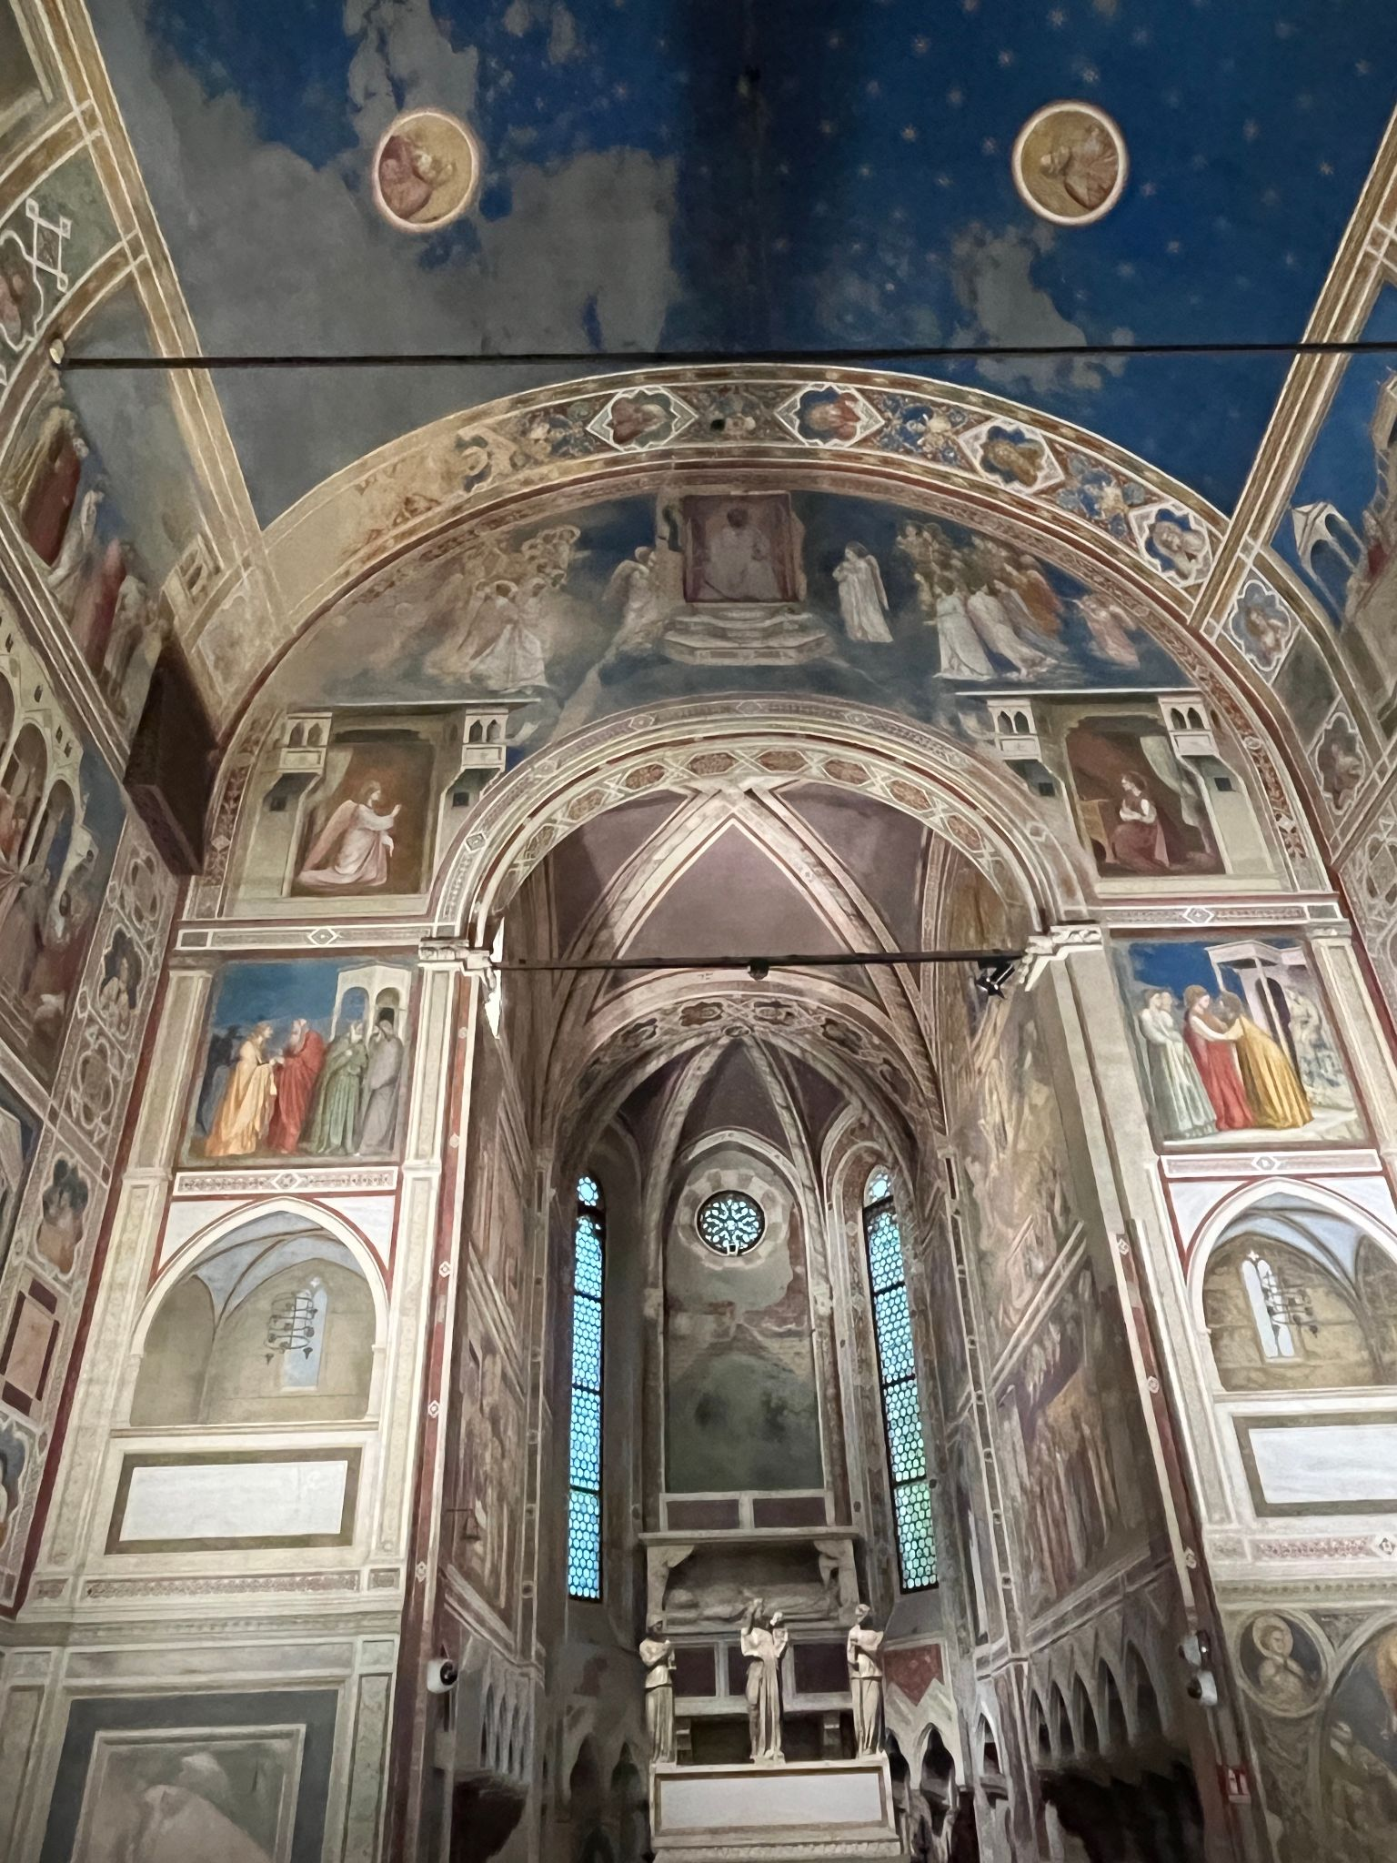
STEAM.4 ﻿﻿ The architecual styles to be found in Padua.
Gothic,
Scrovegni Chapel

Slide 4
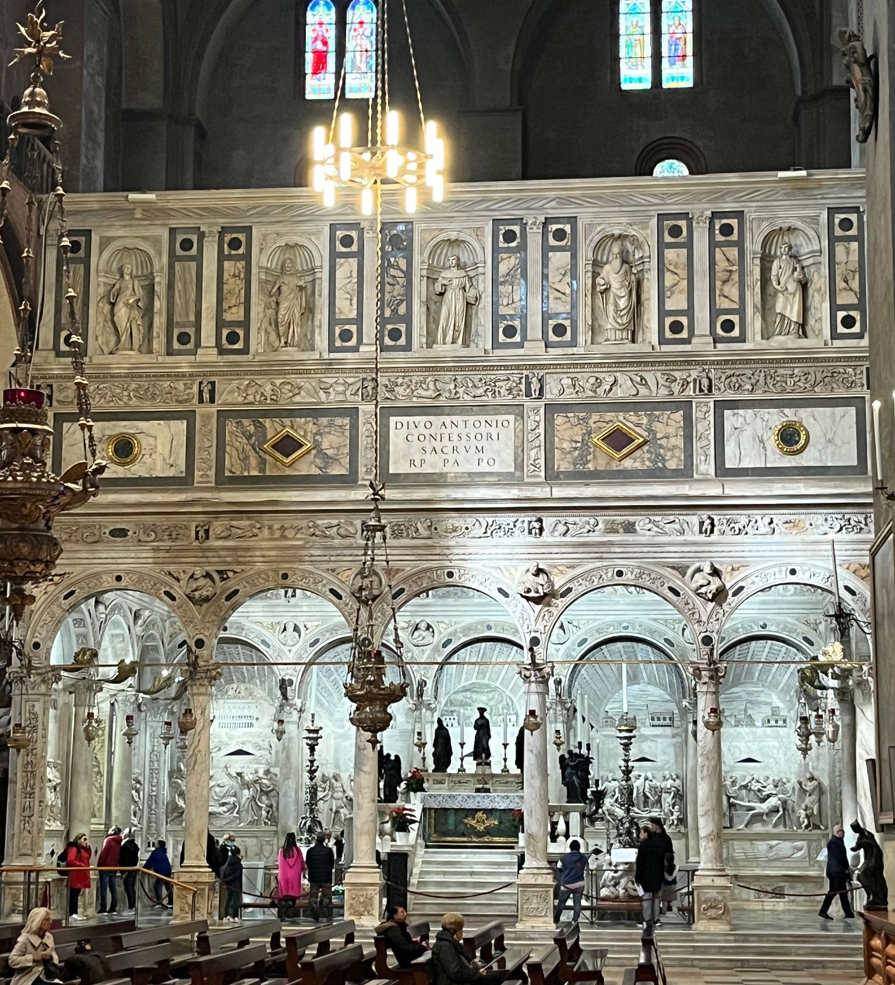
STEAM.4 ﻿﻿ The architecual styles to be found in Padua.
Renassanice,
Saint Anthony Chapel

Slide 5
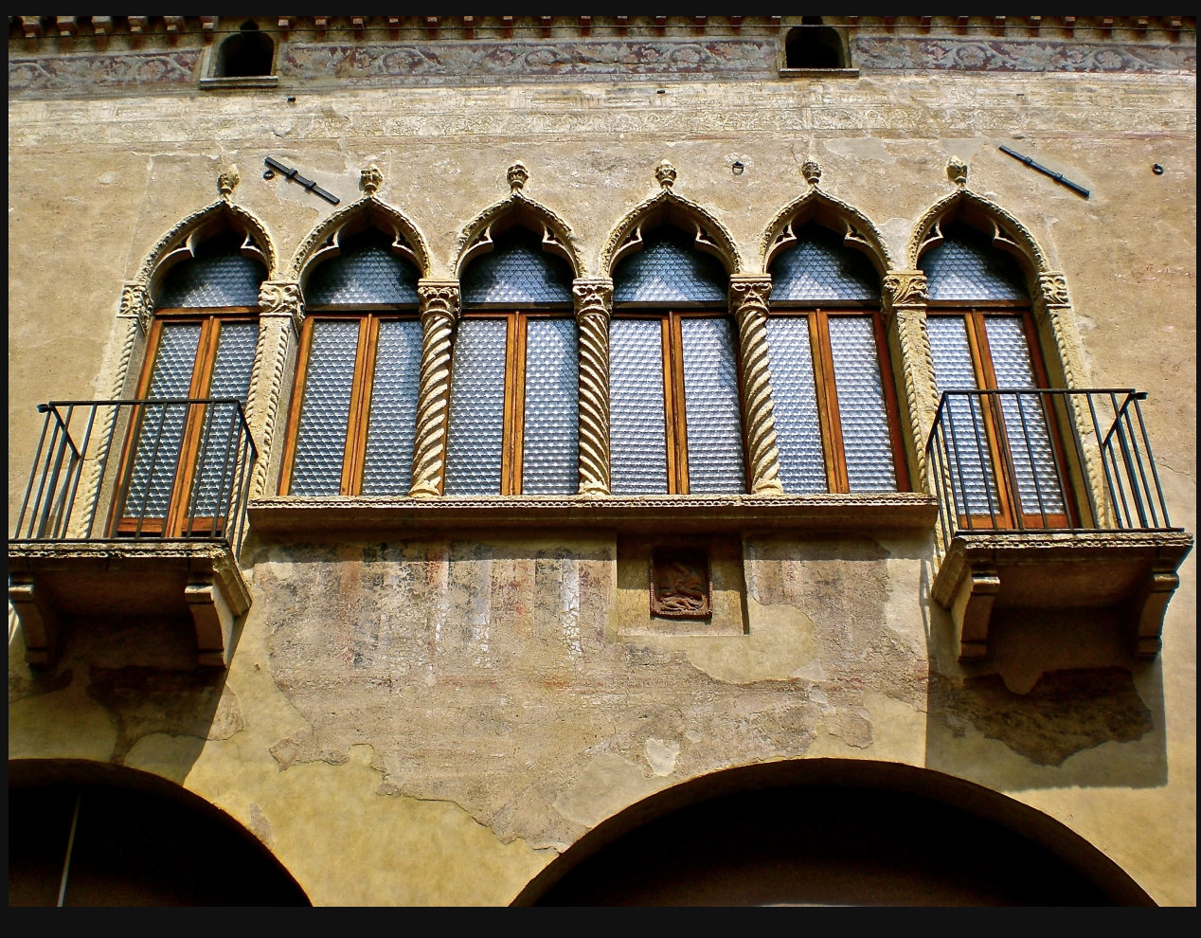
STEAM.4 ﻿﻿ The architecual styles to be found in Padua.
Moorish,
House

Slide 6
STEAM.5 ﻿﻿ The description of the Scrovegni Chappel.
The shape of the building is modest - it is a single-nave, barrel-vaulted chapel, ending in a presbytery with a ribbed vault.
The frescoes in the Scrovegni Chapel were painted by Giotto between 1303 and 1306. The decoration of the chapel was created using optical illusion.
The walls inside the building are smooth, and all the decoration has been painted. The mouldings, cornices and frames, created with a brush, imitate the real thing to the point of being illusory, while drawing an intricate but obvious system of geometric divisions, in which a number of optical corrections, imperceptible to the eye, have been made. The paintings also contain elements of illusion: in the arcade, leading into the presbytery, Giotto painted two hollow chapels, creating an impression of depth, and above them two architectural constructions, which in turn look as if they are detaching from the surface of the wall and are reaching out in front of it.

Slide 7
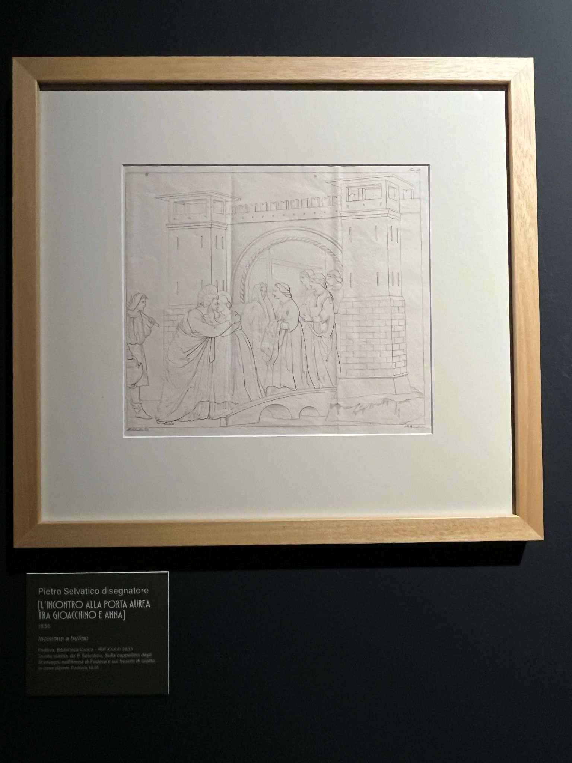
HISTORY AND STORY-TELLING.8 ﻿﻿ The Scrovegni Chapel.
Masterpiece
Frescoes
Precious
Heritage
Monumental
Sacred
Amazing
Groundbreaking
Inspiring
Narrative

Slide 8
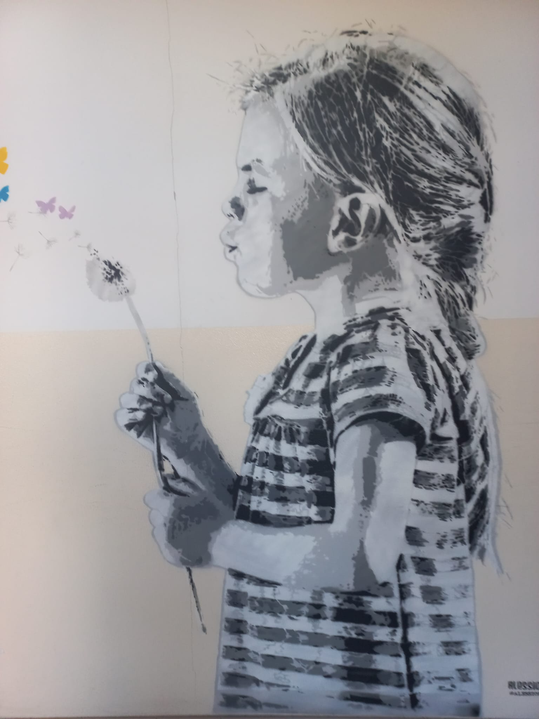
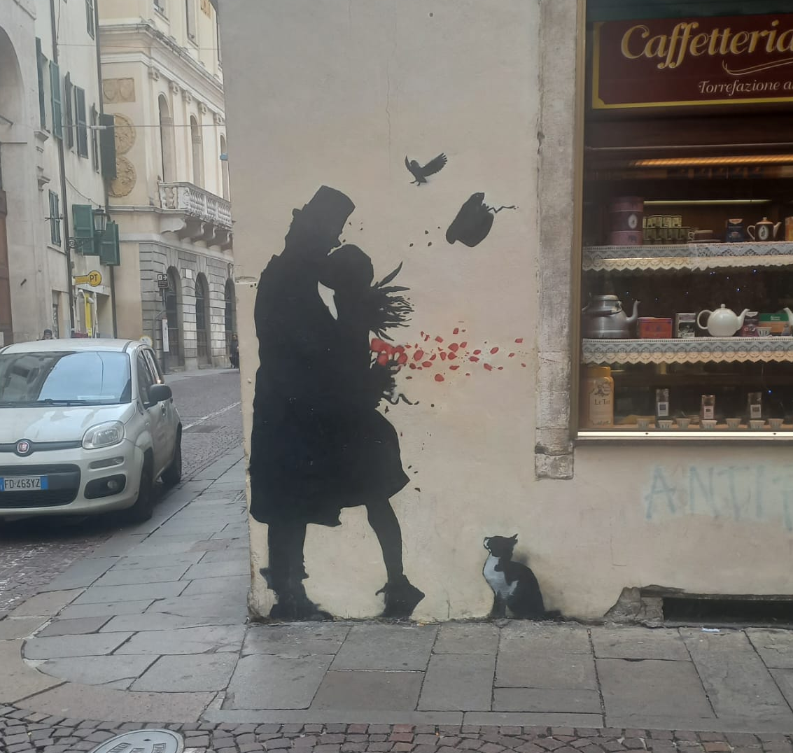
HISTORY AND STORY-TELLING.11 ﻿﻿ Past and Presence - Frescoes / Graffiti
Alesio B.,
Kenny Random

Slide 9
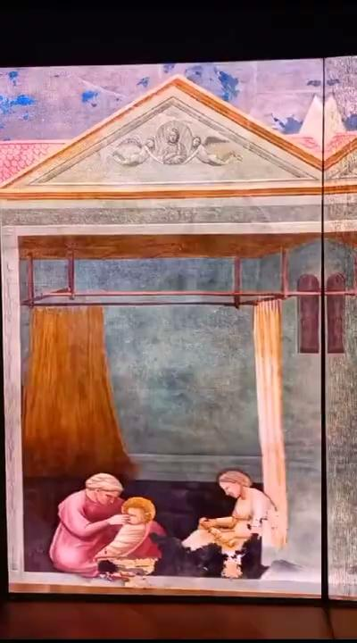
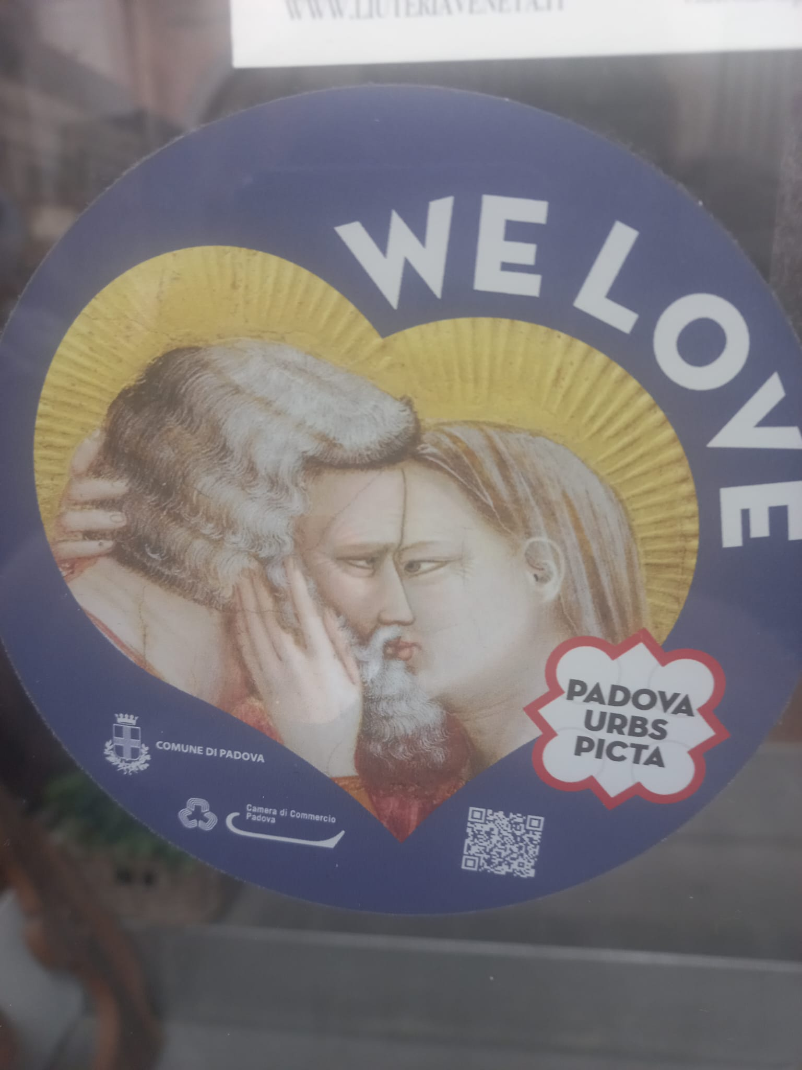
HISTORY AND STORY-TELLING.11 ﻿﻿ Past and Presence - Frescoes / Art / Tourism

Slide 10
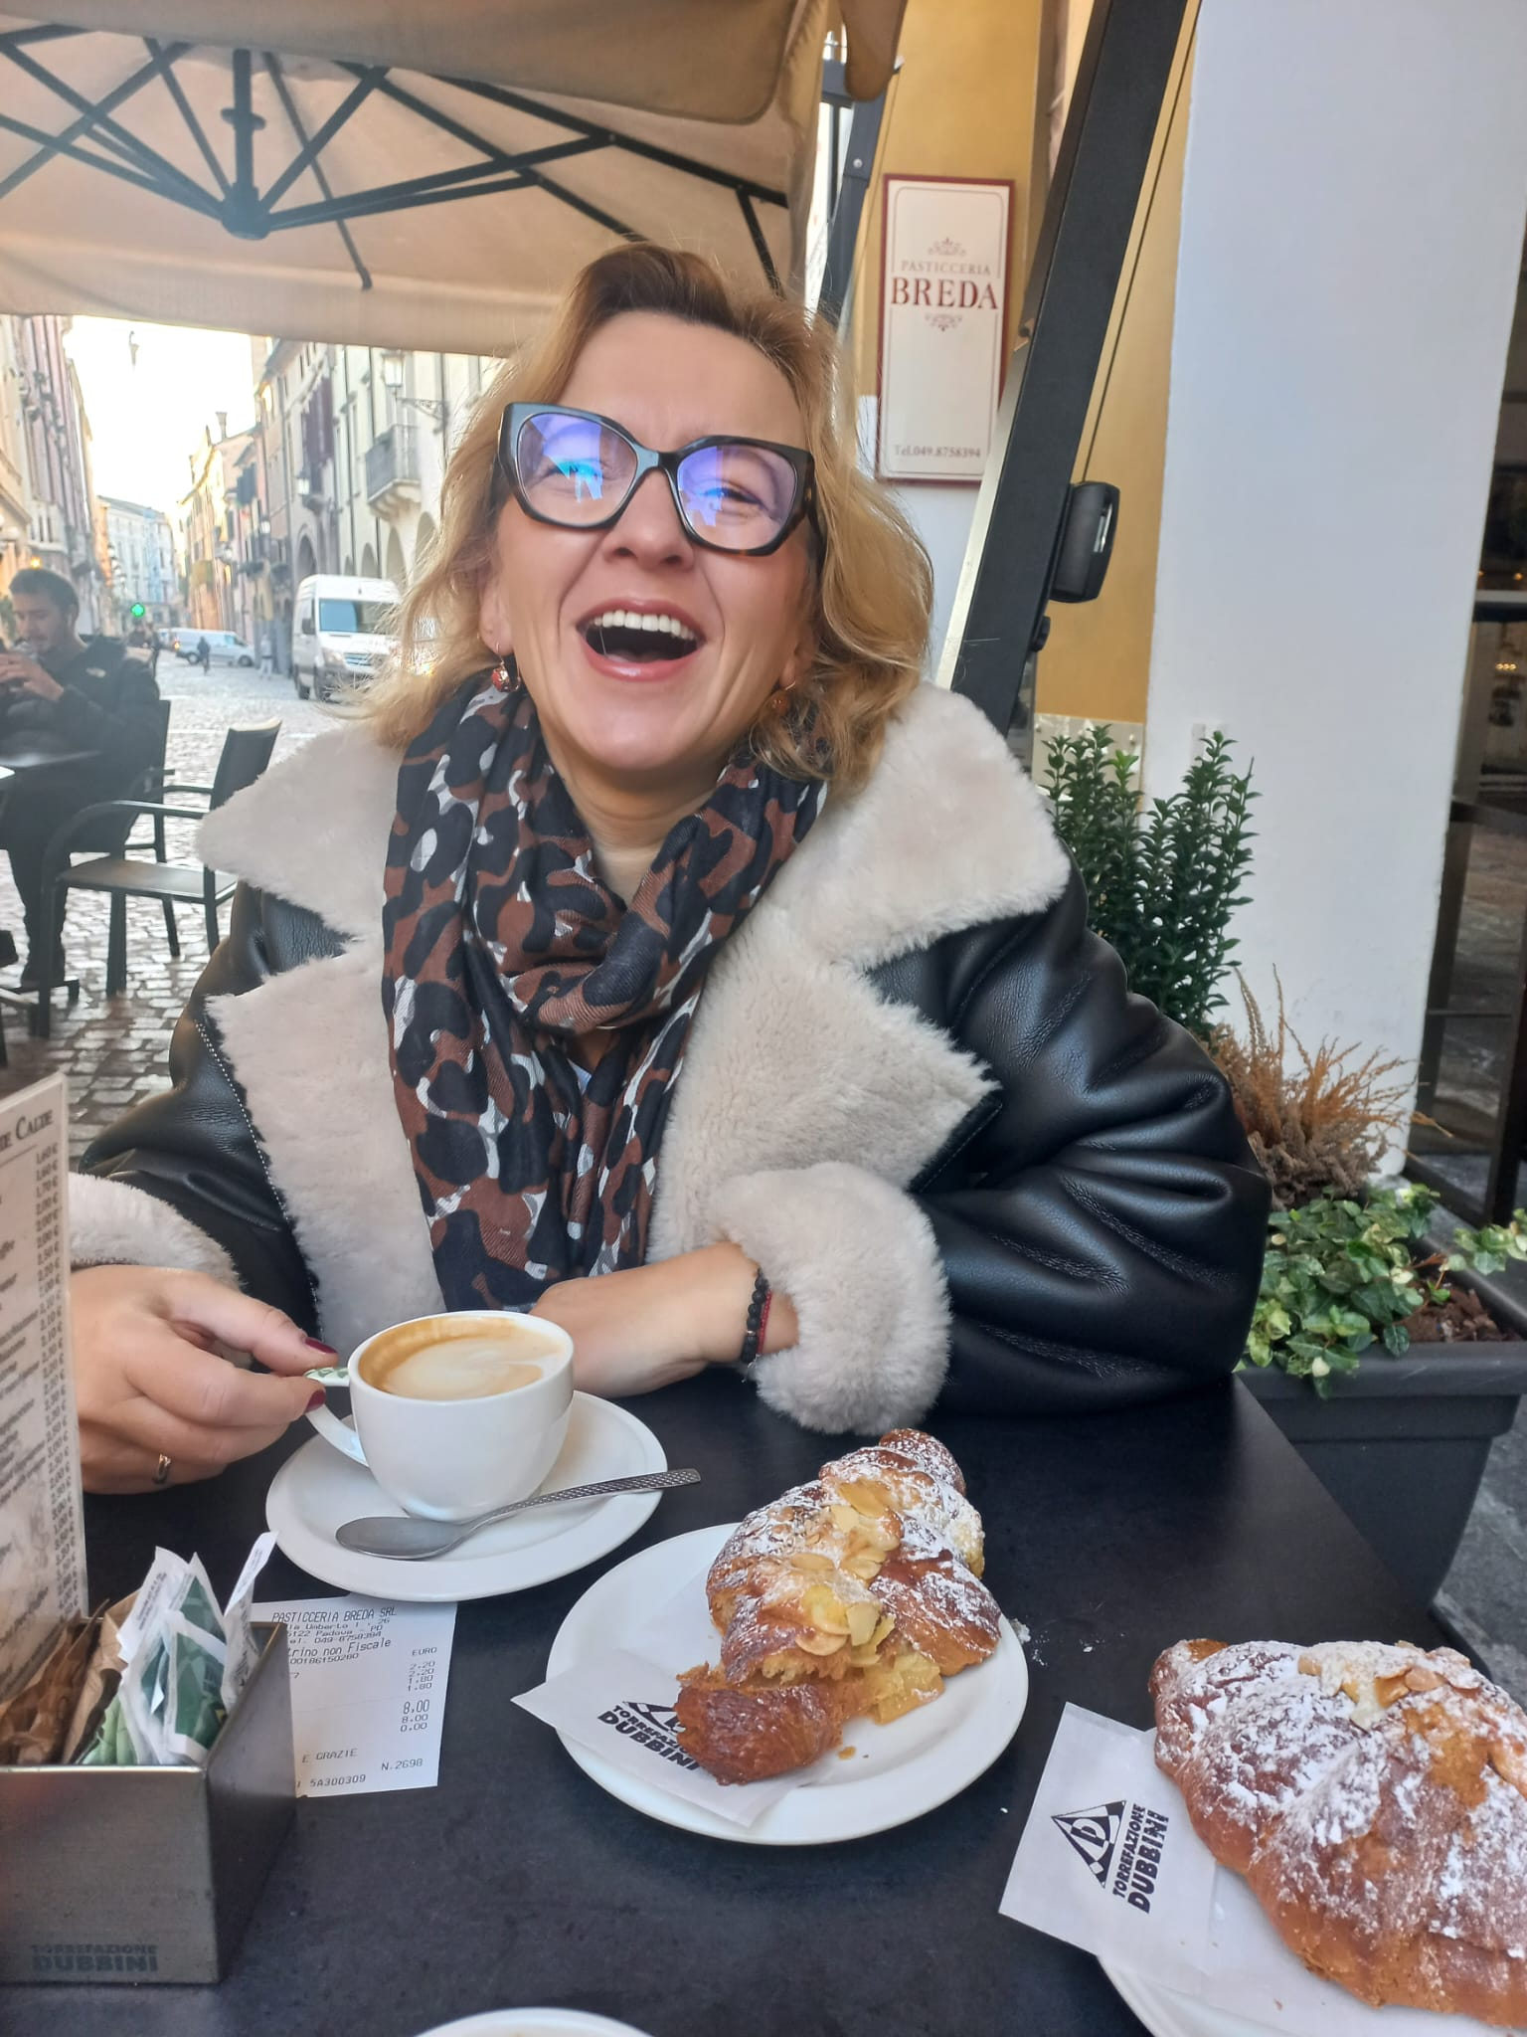

PROBLEM SOLVING.12 Like
Monuments
Architecture
Coffee
Cakes (Izolda)
Fashionable people (Izolda)
Bikes (Beata)

Slide 11
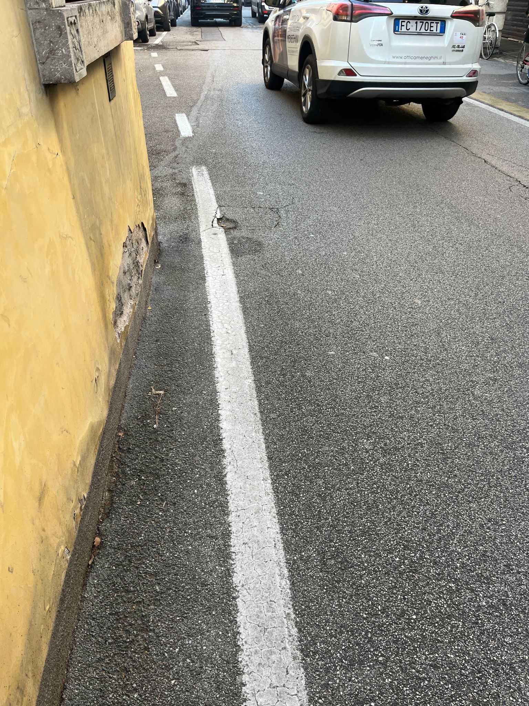
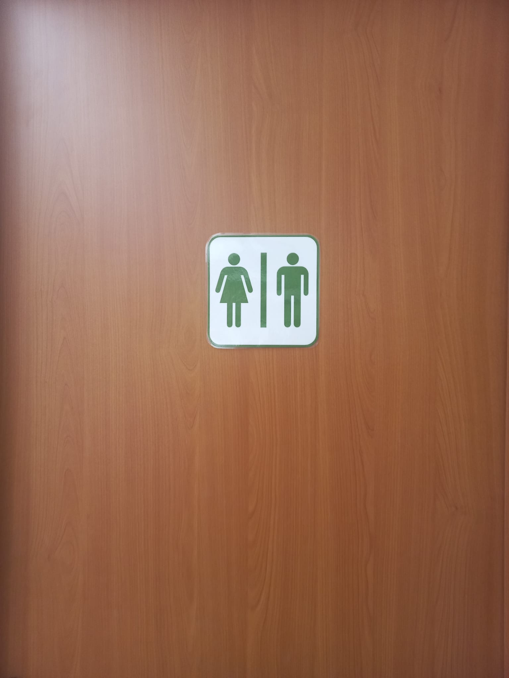

PROBLEM SOLVING.12 Dislike

